Slide 1
Soccer Analysis: 3D Pose Estimation from Television Recordings
Tobias Buner
ETH Zürich
August 28, 2019

Slide 2
Content
Introduction
Related Work
Method
Results and Discussion
Conclusion

Slide 3
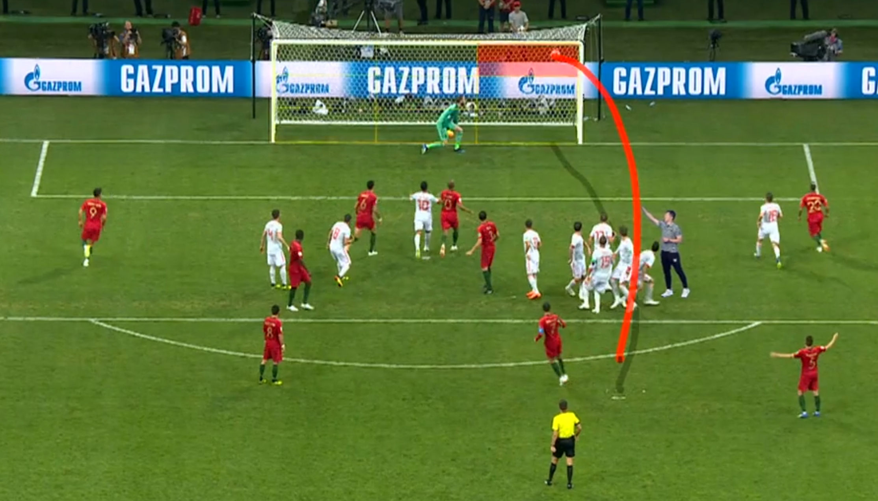
Introduction
Given:
TV recordings
2D tracking data
Goal:
extend to three dimensions
High-end solutions:
Intel True View end-to-end technology solution
Vizrt’s sports graphics and analysis tools

Slide 4
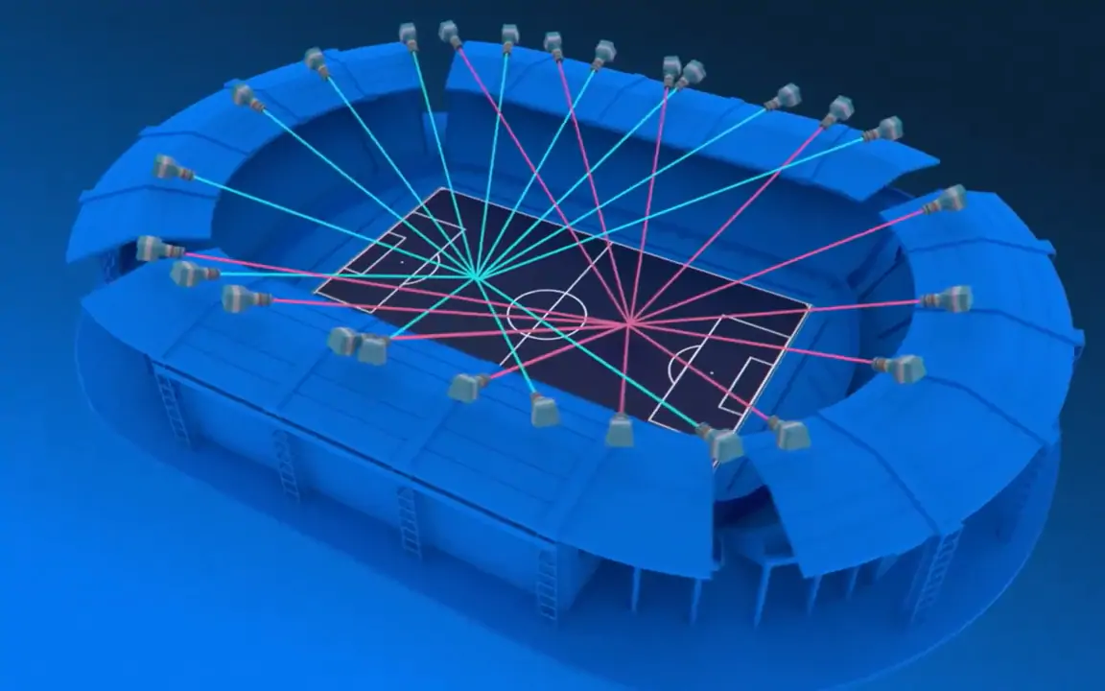
Related Work
High-end solution: Intel True View technology solution

Slide 5
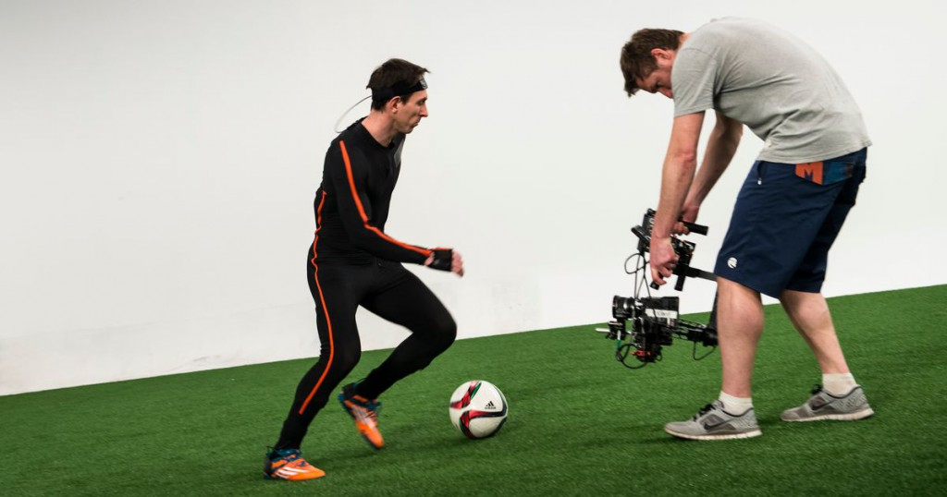
Motion capture (marker-based)
Xsens’s motion capture suit

Slide 6
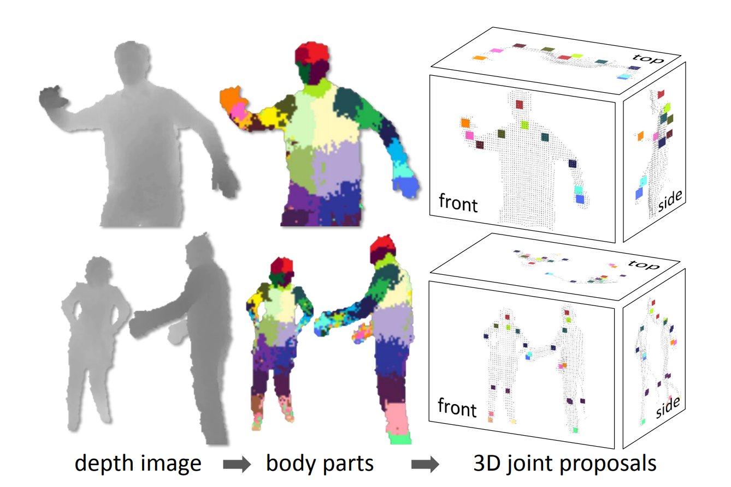
Motion Capture (Markerless)
Microsoft’s Kinect: 3D positions reconstruction from one single depth image

Slide 7
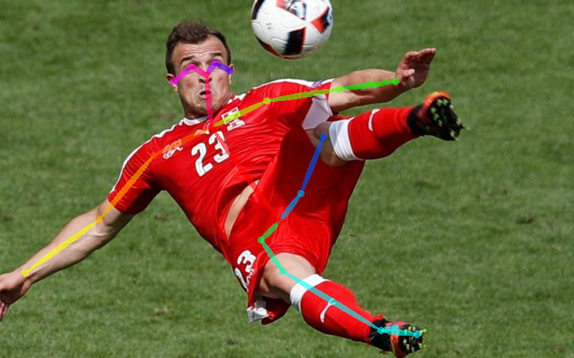
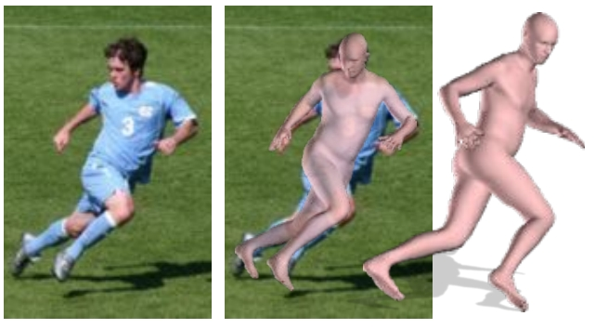
Human Pose Estimation
Human 2D pose estimation:
OpenPose
DeepCut
To understand the 3D geometry:
Fit a statistical body shape model (SMPL) to the 2D joints
Minimizes an objective function (error from the projected 3D model joints and the estimated 2D joints)

Slide 8
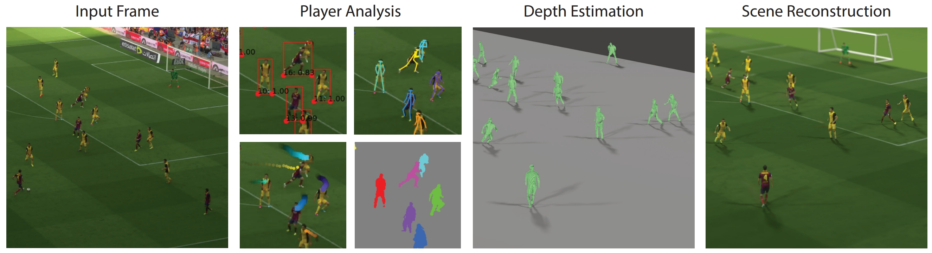
Soccer on your tabletop
Player Analysis Building Blocks:
Detectron
Calibration
OpenPose

Slide 9
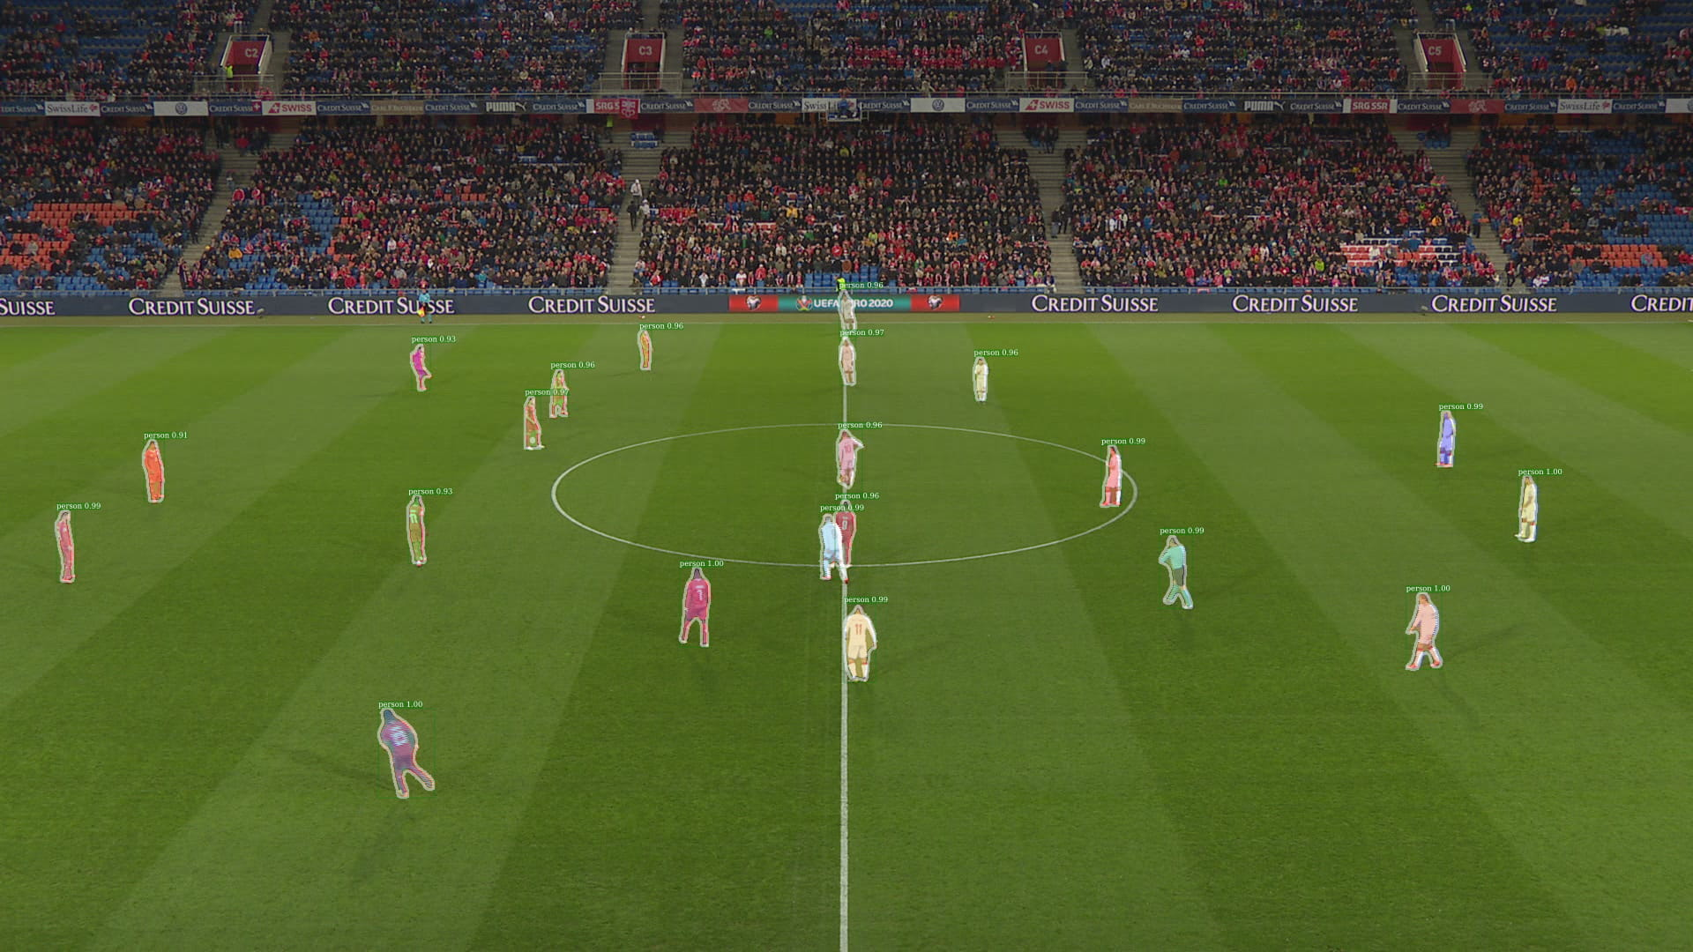
Detectron
Implements multiple state-of-the-art object detection algorithms:
Mask R-CNN
RetinaNet

Slide 10
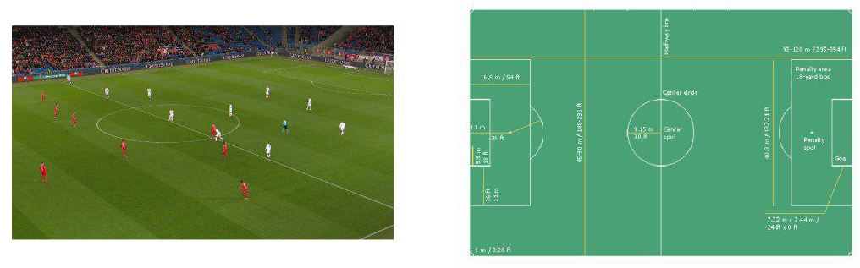
Calibration
First phase:
Manually select four pairs of matching points
Soccer field in x-y plane (3D coordinates)
Grid search for the camera parameters (reprojection error)
Second phase:
Calibration from last frame gets propagated

Slide 11
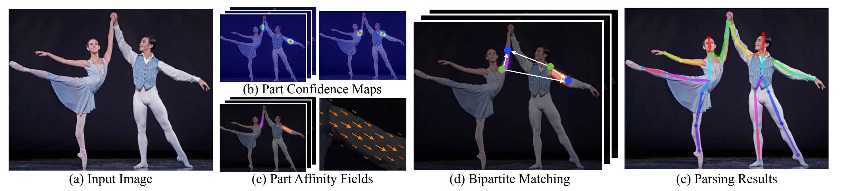
OpenPose
Body part location (confidence maps) – one for each body part
Part affinity fields (PAFs) – encodes position and orientation of the limbs
Map the body parts together (confidence score for each pair) → matching problem

Slide 12
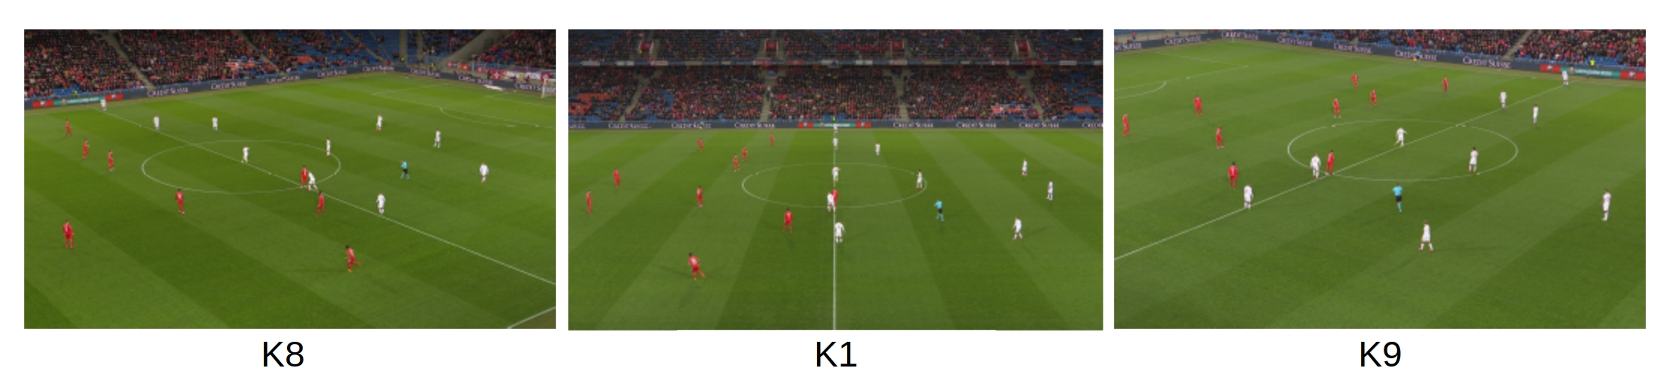
Given Data
Different TV cameras
Two-dimensional tracking data

Slide 13
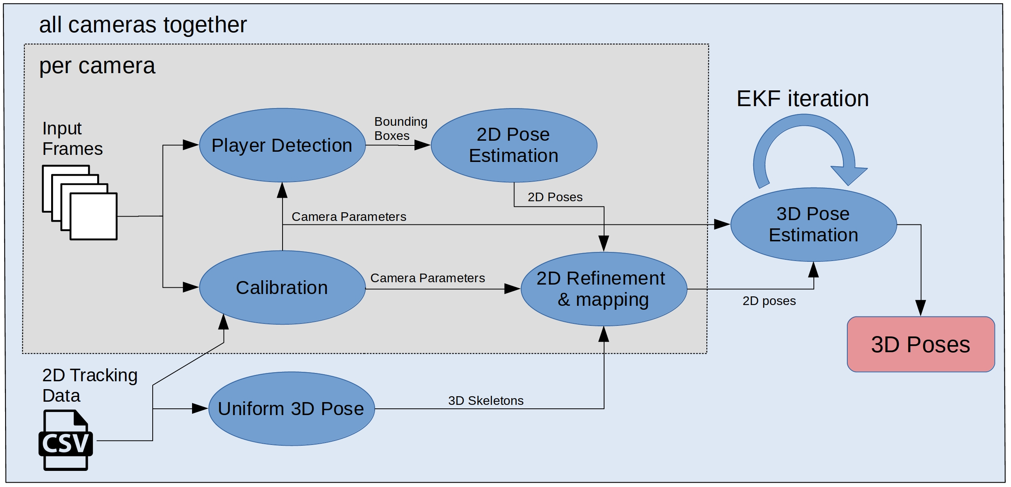
Method

Slide 14
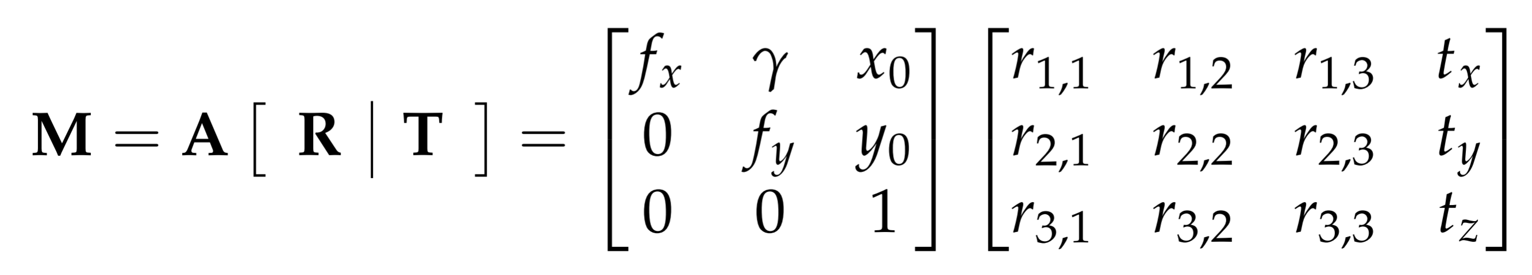
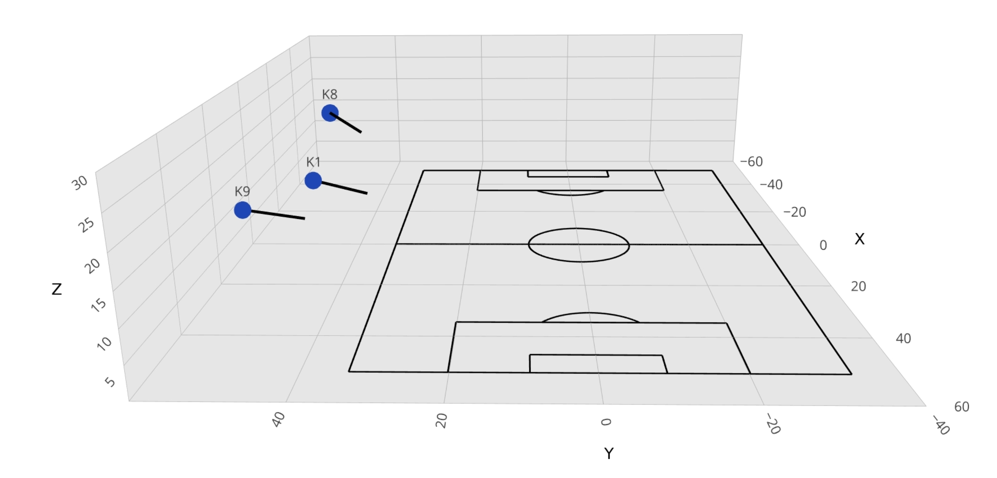
Calibration
Intrinsic and Extrinsic camera matrices
Origin of the world coordinate system is set to the center of the pitch
Metric 2D tracking data
Dimension of the pitch

Slide 15
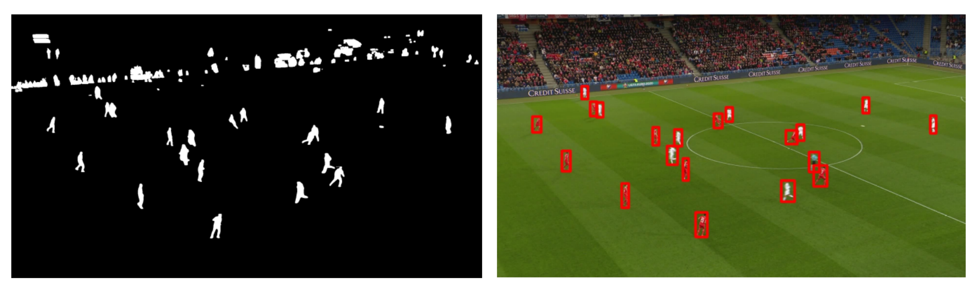
Player detection
Remove irrelevant detections like the spectators with the help of the camera calibration

Slide 16
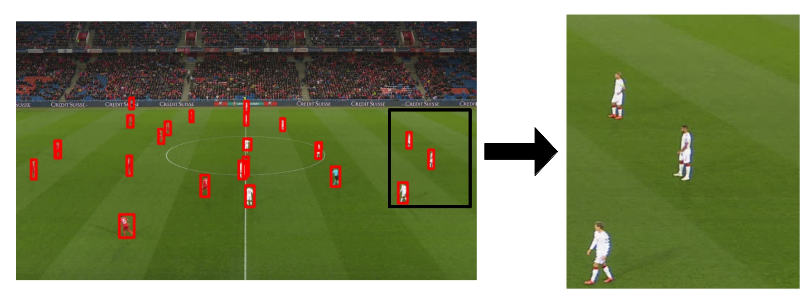
2d Pose estimation
OpenPose is designed for scenarios with the camera close to the ground and small distance

Slide 17
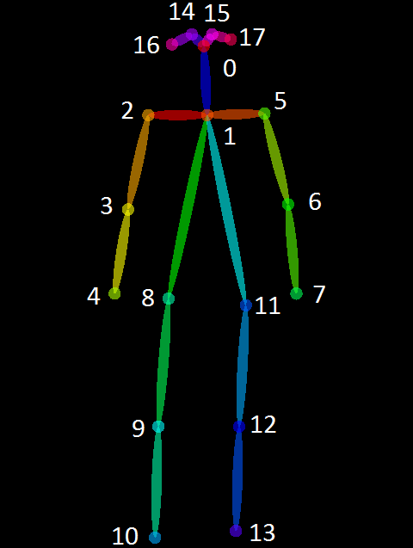
2D Refinement
Keypoint conditions:
Minimal number of keypoints with confidence score unequal to zero
Sum of all confidence scores must exceed a threshold
Confidence score of the neck keypoint (1) must be greater than a given threshold

Slide 18
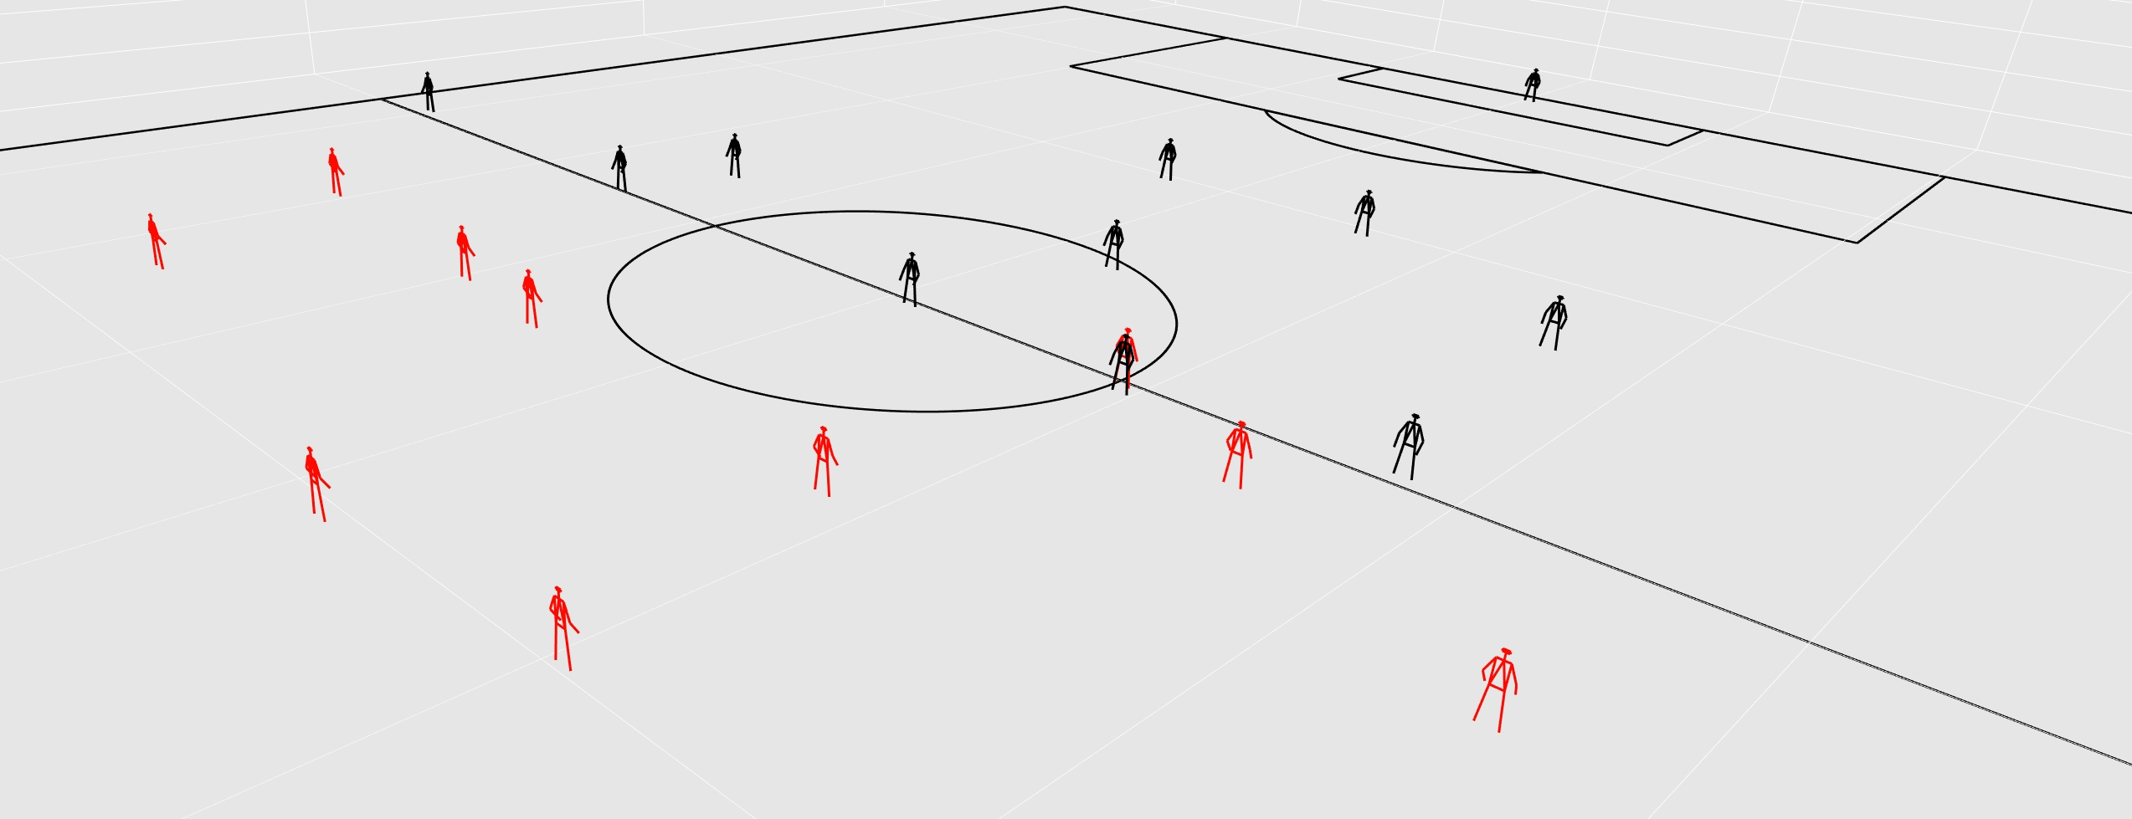
Mapping
2D tracking data used for the mapping (smallest distance)

Slide 19
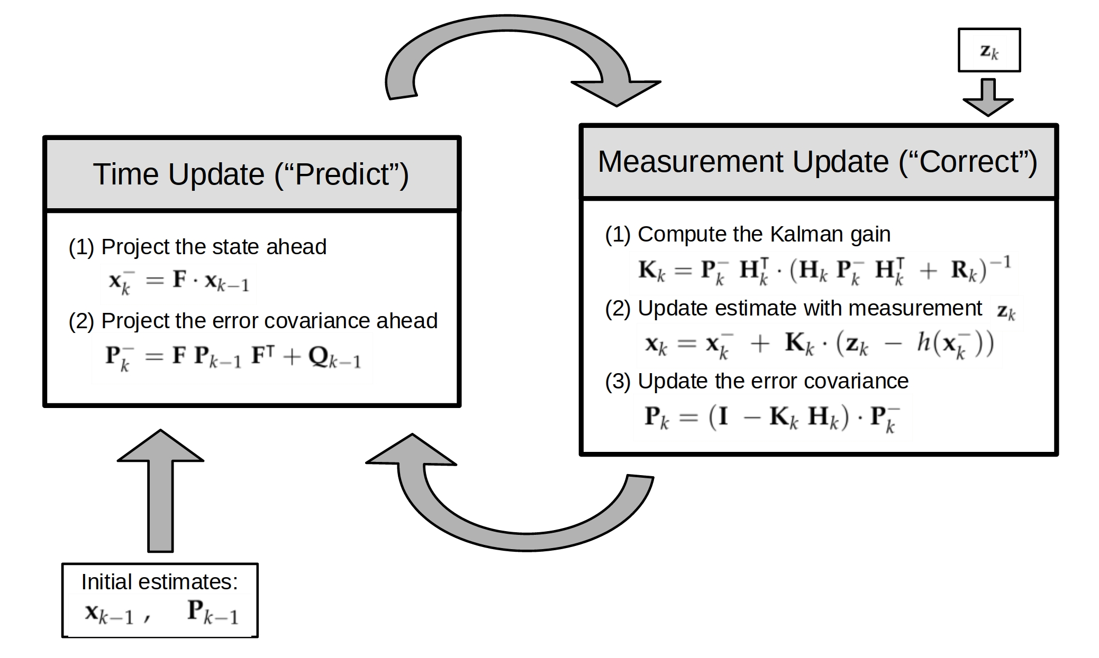
3D Pose fusion (Extended Kalman Filter)

Slide 20


EKF Design
Project the state ahead (constant velocity):
Measurement vector:
$$1$$
𝟏
$$0$$
0
$$0$$
0
$$▲t$$
▲𝒕
$$0$$
0
$$0$$
0
$$0$$
0
$$1$$
𝟏
$$0$$
0
$$0$$
0
$$0$$
0
$$1$$
𝟏
$$0$$
0
$$0$$
0
$$0$$
0
$$0$$
0
$$0$$
0
$$0$$
0
$$1$$
𝟏
$$0$$
0
$$0$$
0
$$0$$
0
$$0$$
0
$$0$$
0
$$0$$
0
$$0$$
0
$$0$$
0
$$0$$
0
$$0$$
0
$$1$$
𝟏
$$0$$
0
$$0$$
0
$$1$$
𝟏
$$0$$
0
$$▲t$$
▲𝒕
$$▲t$$
▲𝒕
$$x_{w}$$
𝑥_𝑤
$$y_{w}$$
𝑦_𝑤
$$z_{w}$$
𝑧_𝑤
$$v_{x}$$
𝑣_𝑥
$$v_{y}$$
𝑣_𝑦
$$v_{z}$$
𝑣_𝑧
$$x_{c_{0}}$$
𝑥_(𝑐_0 )
$$y_{c_{0}}$$
𝑦_(𝑐_0 )
$$x_{c_{1}}$$
𝑥_(𝑐_1 )
$$y_{c_{1}}$$
𝑦_(𝑐_1 )
$$x_{c_{n}}$$
𝑥_(𝑐_𝑛 )
$$y_{c_{n}}$$
𝑦_(𝑐_𝑛 )
⁞
$$x=$$
$$z=$$
Process Model
State vector

Slide 21
Measurement model
Update estimate with measurement (residual):
Function h project the state variable into measurement space
Nonlinear relationship between state space and the measurement space
Initialization:
uniform 3D skeletons
Higher process noise than measurement noise to rely more on the measurements than on the prediction

Slide 22
Problems
No perfect measurements (missing keypoints)
Heuristic approach:
confidence score of some keypoints equal to zero:
→ estimate the missing keypoint proportional to the given keypoints
If the whole pose is missing, we project the three-dimensional prediction to screen coordinates and use them as measurement

Slide 23
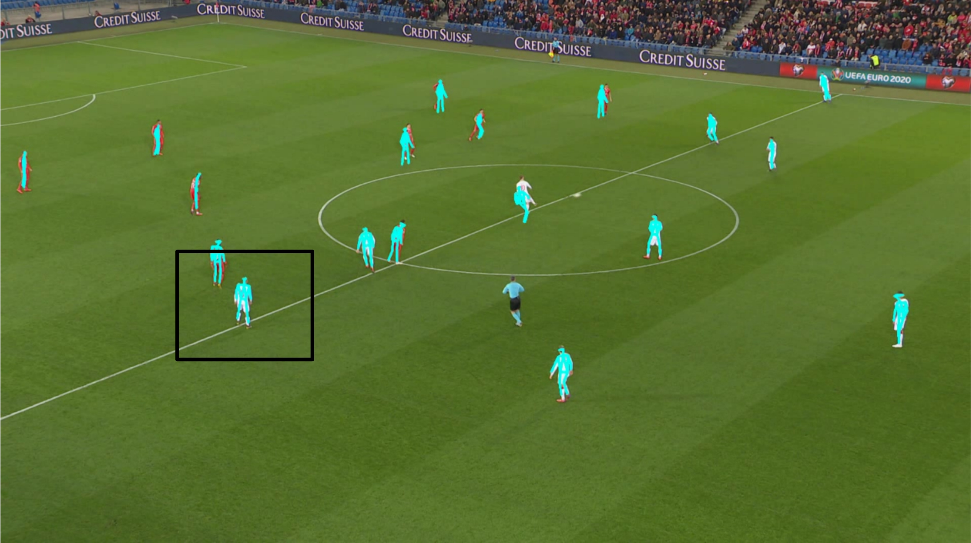
Results and discussion

Slide 24
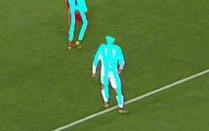

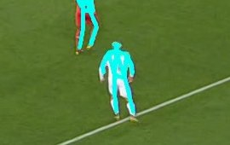
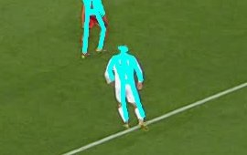
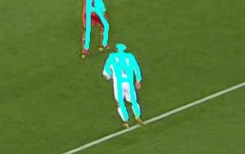
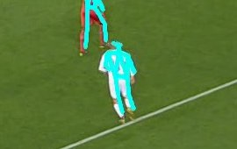
Results and discussion

Slide 25
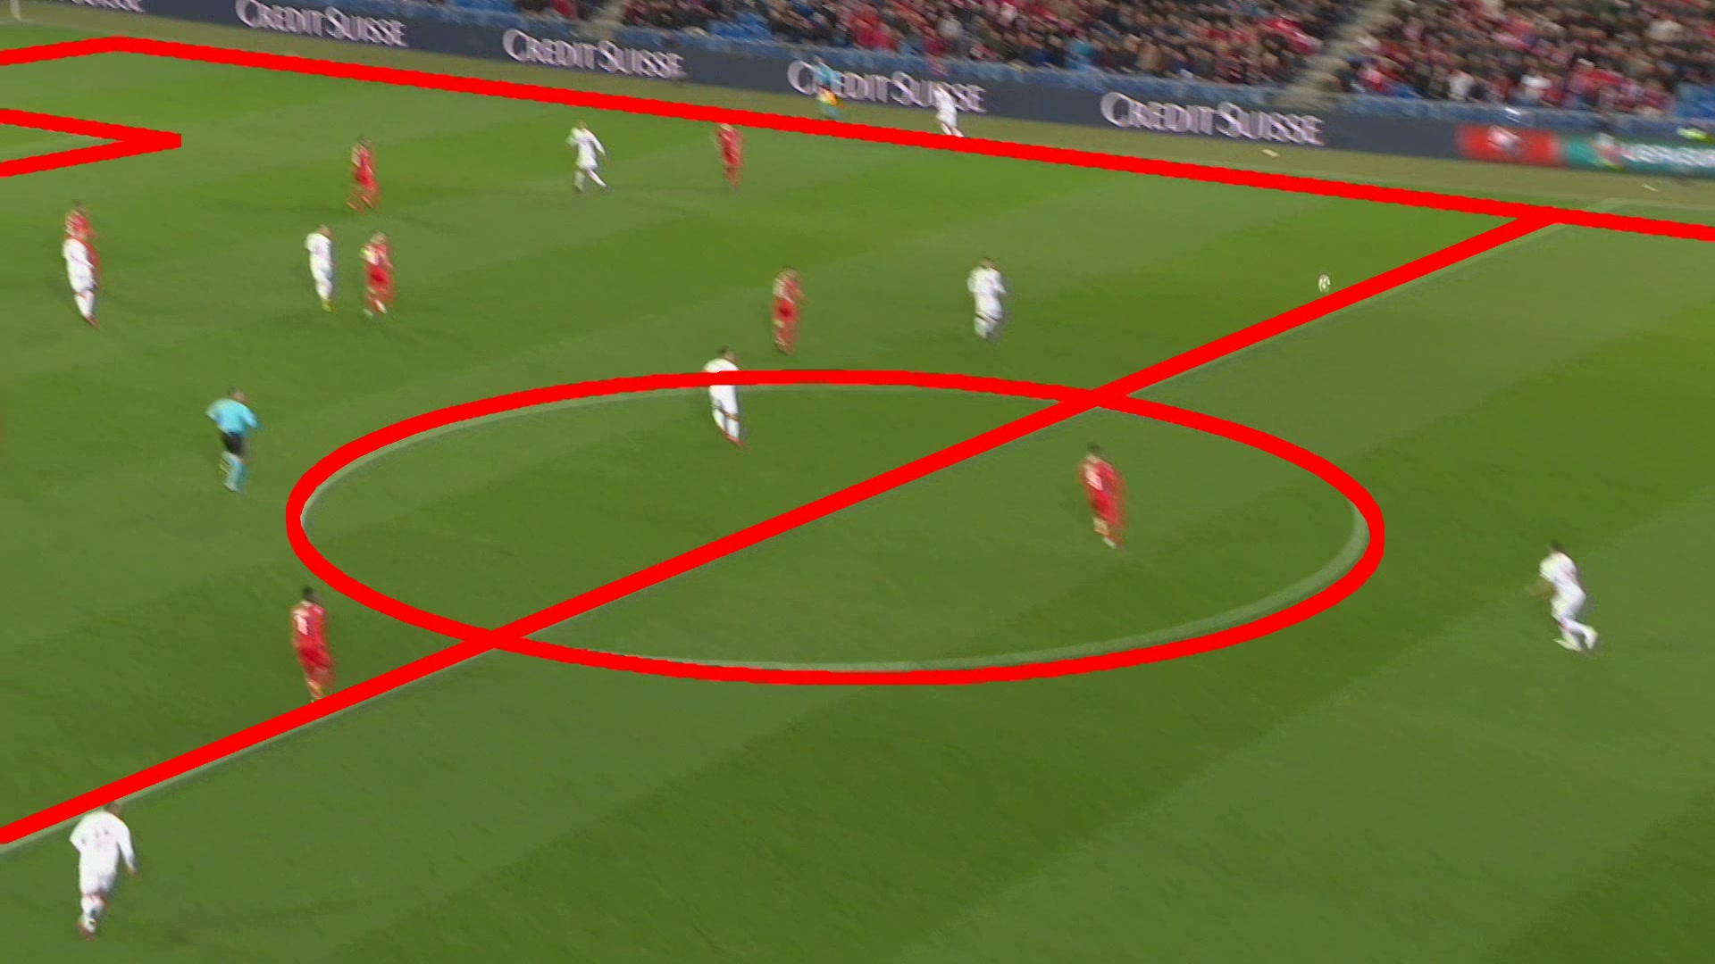
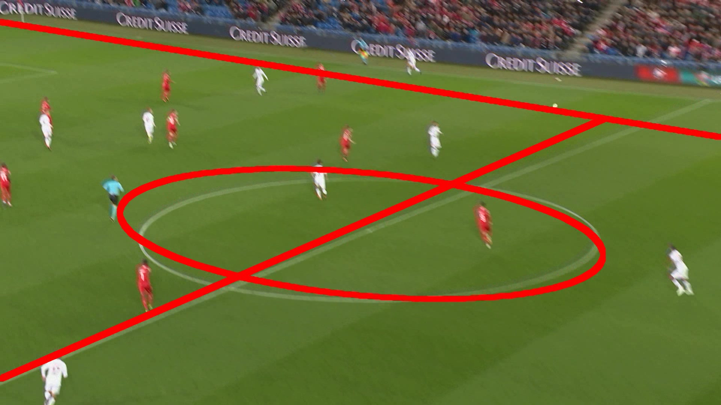
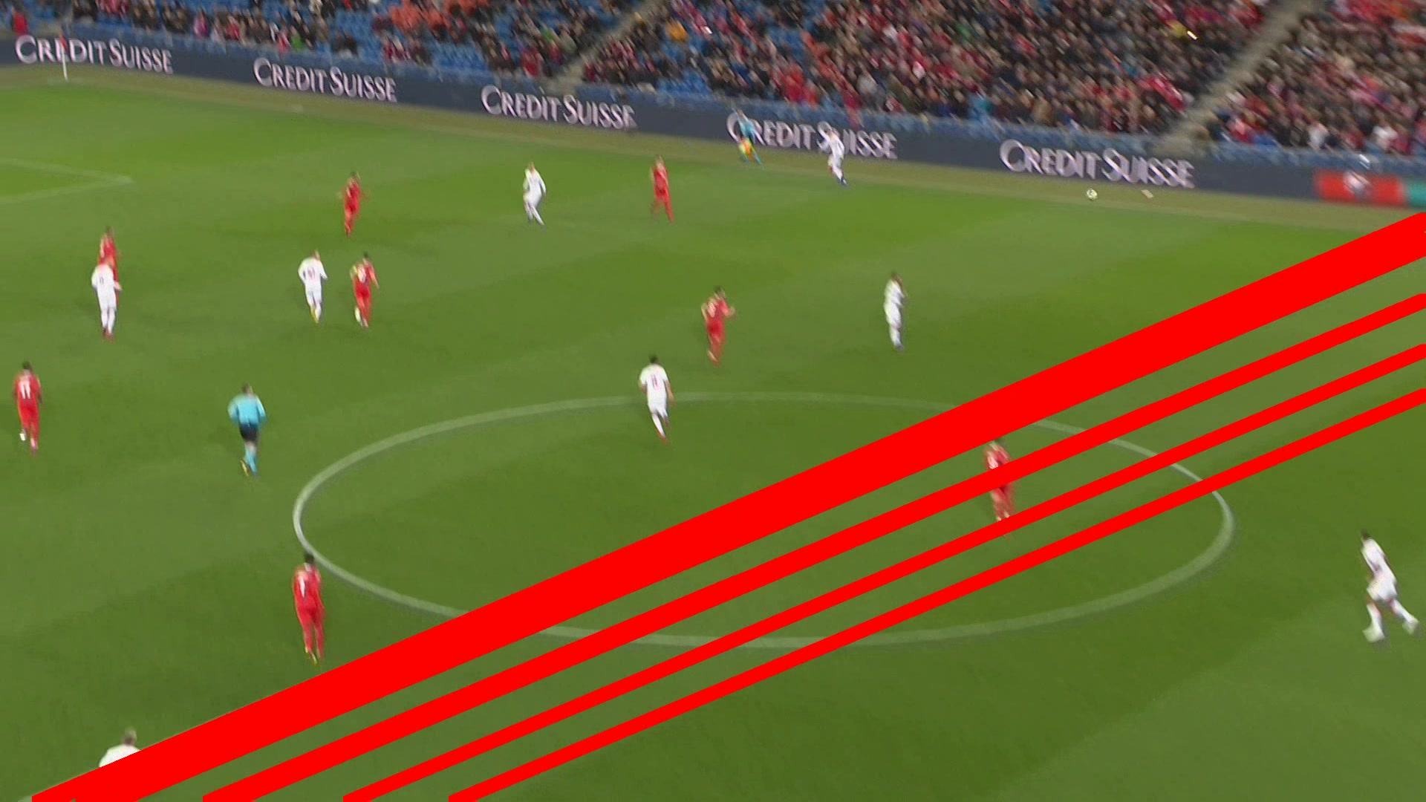
Calibration Failure

Slide 26
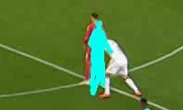
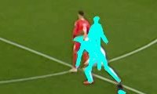
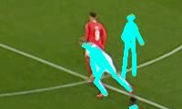
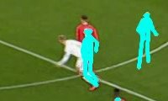
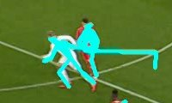
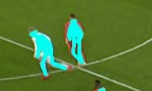
Concealed players

Slide 27
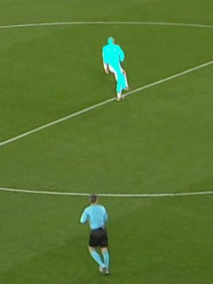
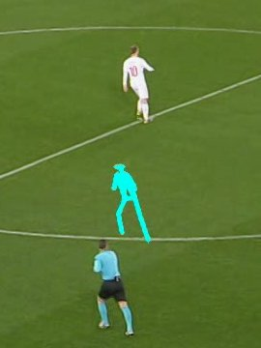
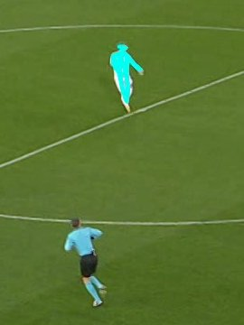
Missing poses

Slide 28
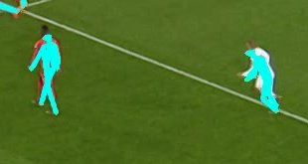
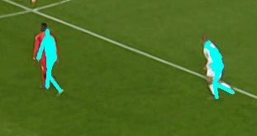
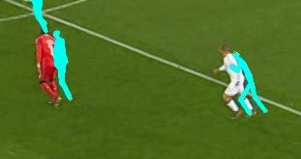
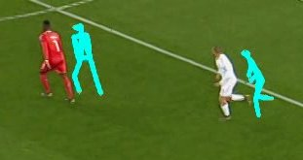
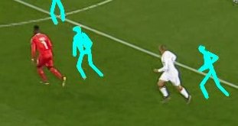
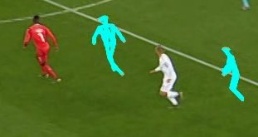
DRIFT

Slide 29
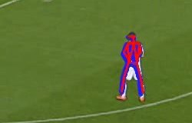
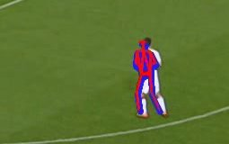
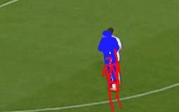
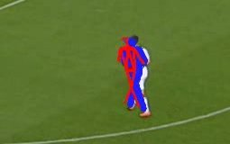
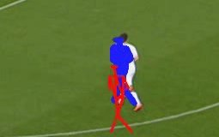
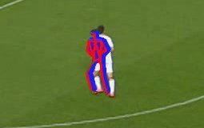
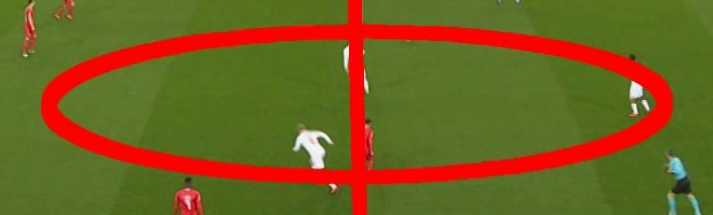


Camer CAlibration

Slide 30

Openpose results (k8)

Slide 31

Openpose results (k9)

Slide 32
Conclusion
System works for a short scene
Limitations:
Camera calibration
Incomplete measurements, no view from the other side
Drift bug
Future work:
Calibration (include to EKF, fisheye)
Motion model for prediction
Upsampling crops for the players in the back

